Slide 1
Chapter 5 – System Modeling
CSE 319
Software Engineering
Credit Hr. 3.00, Contact Hr. 3.00
Lec Tarannum Zaki
Dept of CSE
MIST

Slide 2
Topics covered
Context models
Interaction models
Structural models
Behavioral models
Model-driven engineering

Slide 3
System modeling
System modeling is the process of developing abstract models of a system, with each model presenting a different view or perspective of that system.
System modeling has now come to mean representing a system using some kind of graphical notation, which is now almost always based on notations in the Unified Modeling Language (UML).
System modelling helps the analyst to understand the functionality of the system and models are used to communicate with customers.

Slide 4
Existing and planned system models
Models of the existing system are used during requirements engineering. They help clarify what the existing system does and can be used as a basis for discussing its strengths and weaknesses. These then lead to requirements for the new system.
Models of the new system are used during requirements engineering to help explain the proposed requirements to other system stakeholders. Engineers use these models to discuss design proposals and to document the system for implementation.
In a model-driven engineering process, it is possible to generate a complete or partial system implementation from the system model.

Slide 5
System perspectives
An external perspective, where you model the context or environment of the system.
An interaction perspective, where you model the interactions between a system and its environment, or between the components of a system.
A structural perspective, where you model the organization of a system or the structure of the data that is processed by the system.
A behavioral perspective, where you model the dynamic behavior of the system and how it responds to events.

Slide 6
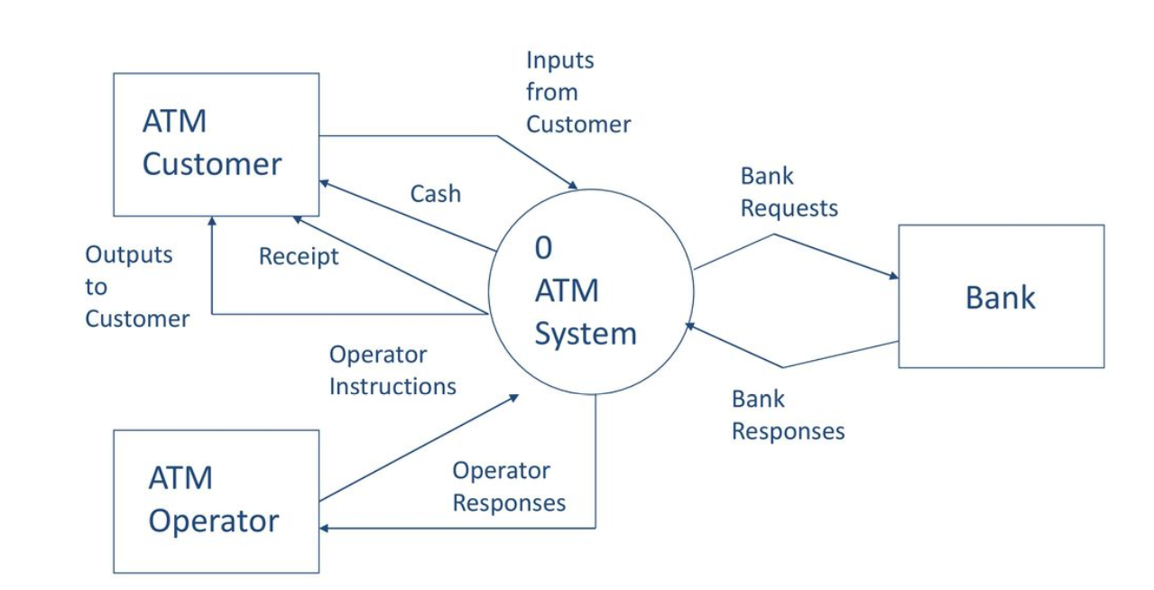
System perspectives – External

Slide 7
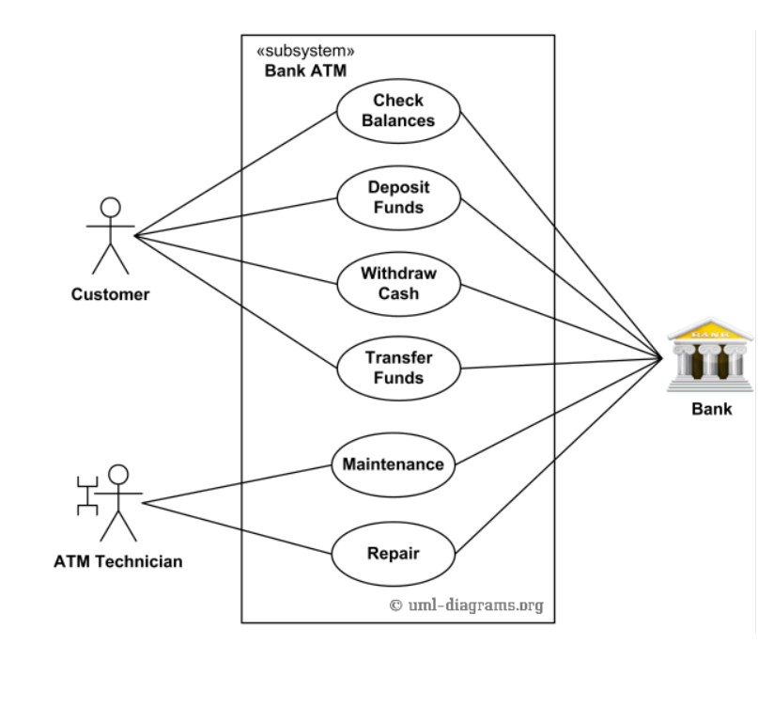
System perspectives – Interaction

Slide 8
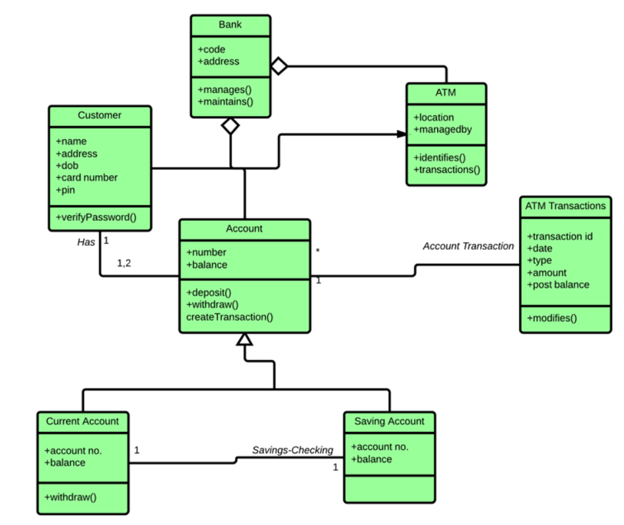
System perspectives – Structural

Slide 9
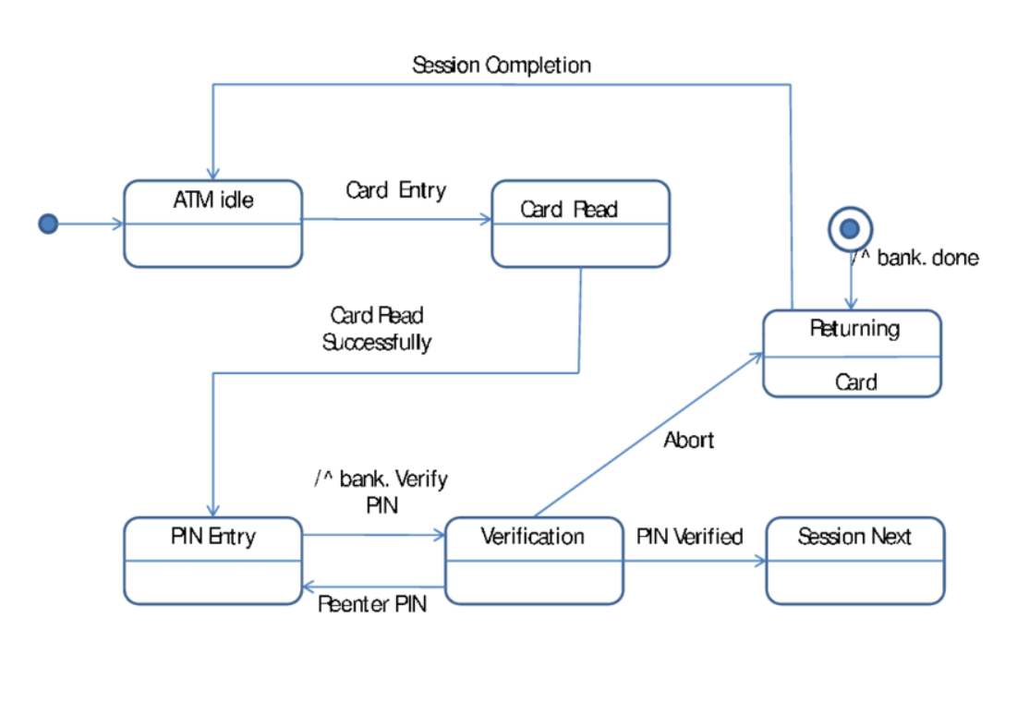
System perspectives – Behavioral

Slide 10
UML diagram types
Activity diagrams, which show the activities involved in a process or in data processing .
Use case diagrams, which show the interactions between a system and its environment.
Sequence diagrams, which show interactions between actors and the system and between system components.
Class diagrams, which show the object classes in the system and the associations between these classes.
State diagrams, which show how the system reacts to internal and external events.

Slide 11
Use of graphical models
As a means of facilitating discussion about an existing or proposed system
Incomplete and incorrect models are OK as their role is to support discussion.
As a way of documenting an existing system
Models should be an accurate representation of the system but need not be complete.
As a detailed system description that can be used to generate a system implementation
Models have to be both correct and complete.

Slide 12
External Model: Context Model

Slide 13
Context models
Context models are used to illustrate the operational context of a system - they show what lies outside the system boundaries.
System boundaries are established to define what is inside and what is outside the system.
They show other systems (can be an entity or object) that are used or depend on the system being developed.
Defining a system boundary is a political judgment
There may be pressures to develop system boundaries that increase / decrease the influence or workload of different parts of an organization.

Slide 14
Context models
Context models normally show that the environment includes several other automated systems.
However, they do not show the types of relationships between the systems in the environment.
External systems might produce data for or consume data from the system.
They might share data with the system, or they might be connected directly, through a network or not connected at all.
Generally, a single context diagram is modeled for the whole system.

Slide 15
Context models
Rectangle symbol is used to represent the systems in an environment.
Main system can be represented with a different symbol (e.g. circle) and other systems can be represented using a rectangle.
Usually relationships are not specified between systems so association between systems is represented using simple connector lines.
As external systems might exchange data with the main system so such relationship can be represented using arrow-based connector lines.
The exchanged data is specified above the arrow-based connector lines.

Slide 16
The context of the Mentcare system

Slide 17
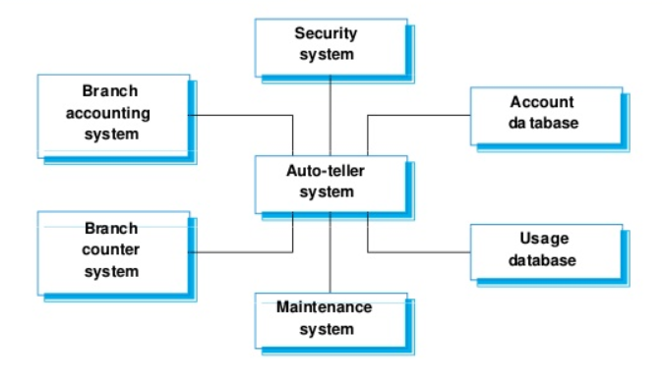
The context of the ATM system

Slide 18
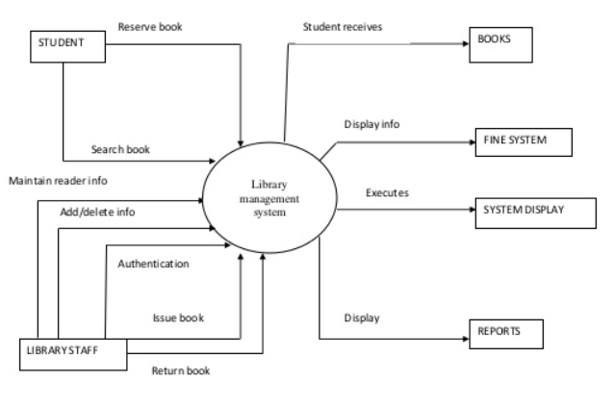
The context of the Library Management system

Slide 19
The context of the ATM system

Slide 20
Process perspective
Context models simply show the other systems in the environment, not how the system being developed is used in that environment.
Process models reveal how the system being developed is used in broader business processes.
UML activity diagrams may be used to define business process models.

Slide 21
External Model: Activity Diagram

Slide 22
Activity Diagram
Activity diagrams are intended to show the activities that make up a system process and the flow of control from one activity to another.
The start of a process is indicated by a filled circle; the end by a filled circle inside another circle.
Rectangles with round corners represent activities, that is, the specific sub-processes that must be carried out.
Arrows represent the flow of work from one activity to another.
Arrows may be annotated with guards that indicate the condition when that flow is taken.

Slide 23
Activity Diagram
A solid bar is used to indicate activity coordination.
When the flow from more than one activity leads to a solid bar then all of these activities must be complete before progress is possible.
When the flow from a solid bar leads to a number of activities, these may be executed in parallel.
There can be a single activity diagram for the entire system (preferably if the system is small).
There can be multiple activity diagrams for different process of a system (preferably if the system is large).

Slide 24
Activity diagram of involuntary detention process of Mentcare system

Slide 25
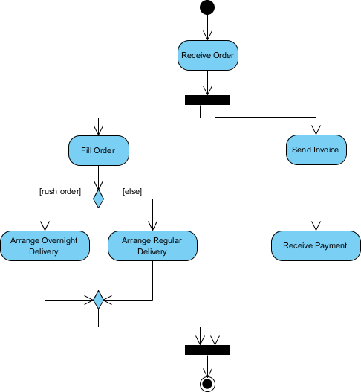
Activity diagram of online order process (seller side)

Slide 26
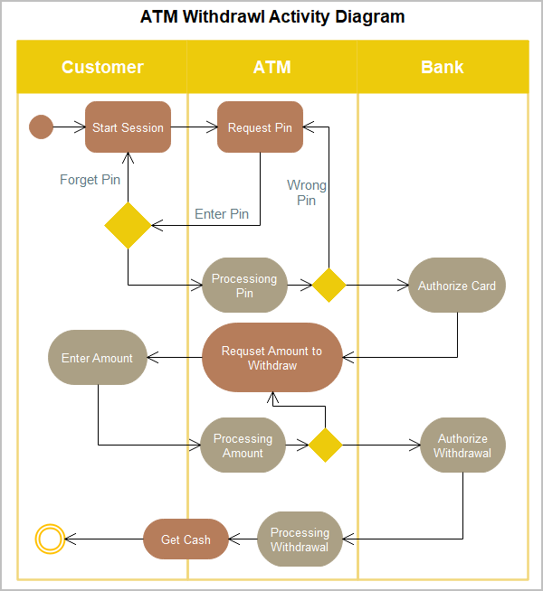
Activity diagram of ATM withdrawal process

Slide 27
Interaction Model: Use Case Diagram Sequence Diagram

Slide 28
Interaction models
Modeling user interaction is important as it helps to identify user requirements.
Modeling system-to-system interaction highlights the communication problems that may arise.
Modeling component interaction helps us understand if a proposed system structure is likely to deliver the required system performance and dependability.
Use case diagrams and Sequence diagrams may be used for interaction modeling.

Slide 29
Interaction models
Use case modeling, which is mostly used to model interactions between a system and external actors (users or other systems).
Sequence diagrams, which are used to model interactions between system components, although external agents may also be included.
Use case models and sequence diagrams present interaction at different levels of detail and so may be used together.
The details of the interactions involved in a high-level use case may be documented in a sequence diagram.

Slide 30
Use case modeling
Use cases were developed originally to support requirements elicitation and now incorporated into the UML.
Each use case represents a discrete task that involves external interaction with a system.
Actors in a use case may be user or other systems.
Represented diagrammatically to provide a fairly simple overview of the use case. For more detailed understanding:
Simple textual description
Structured tabular description
Sequence diagram

Slide 31
Use case modeling
The stick figure notation indicates user, other external systems or hardware known as actor.
Formally, relationship in use case diagrams should use lines without arrows because use case messages pass in both directions.
Functionalities to be represented using oval shape known as use case.
The name of a use case is very important. The name should be chosen in such a way so that it can identify the functionalities performed.

Slide 32
Transfer-data use case
A use case in the Mentcare system

Slide 33
Use cases in the Mentcare system involving the role ‘Medical Receptionist’

Slide 34
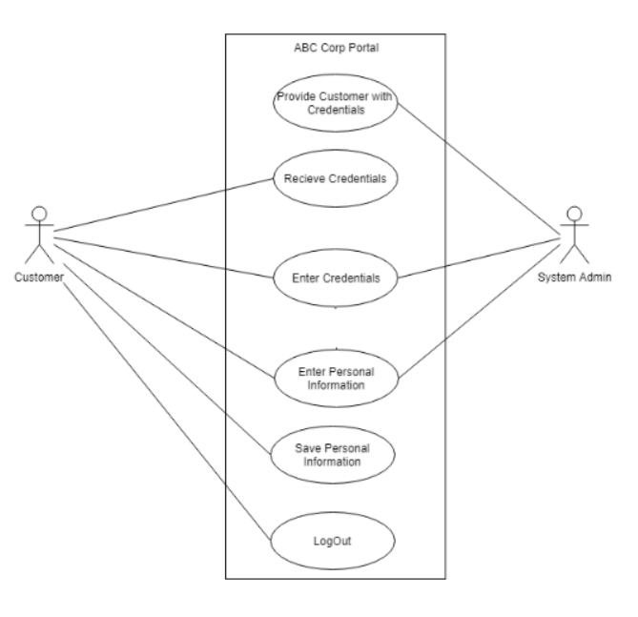
Basic registration use case

Slide 35
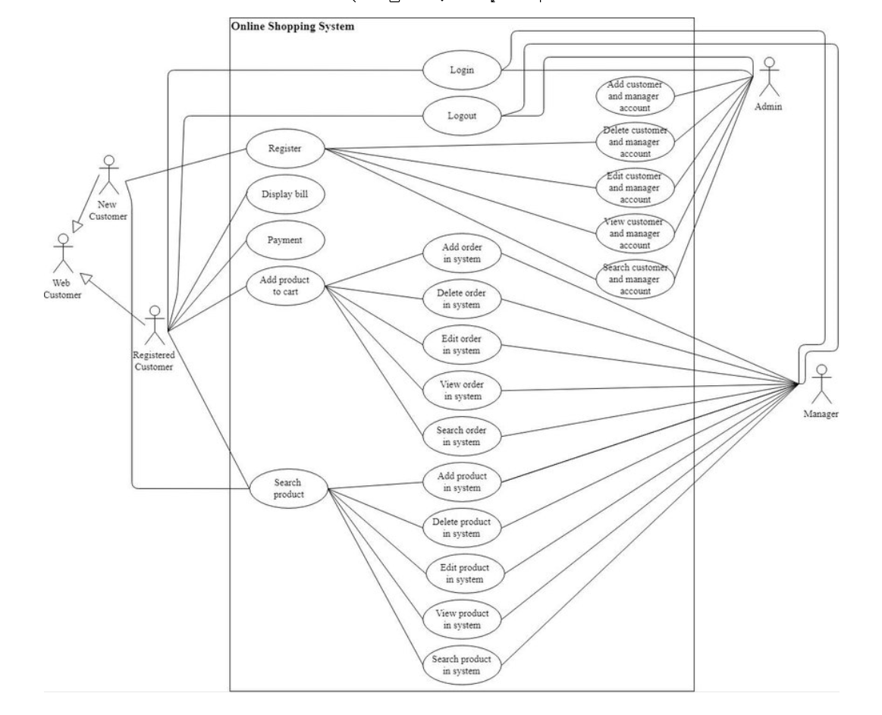
Online shopping system use case

Slide 36
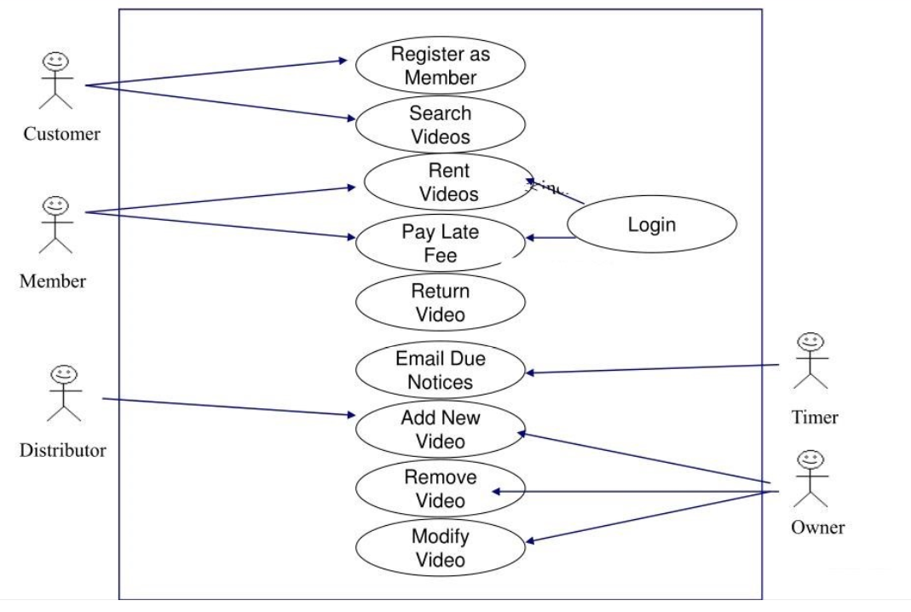
Online video distribution system use case

Slide 37
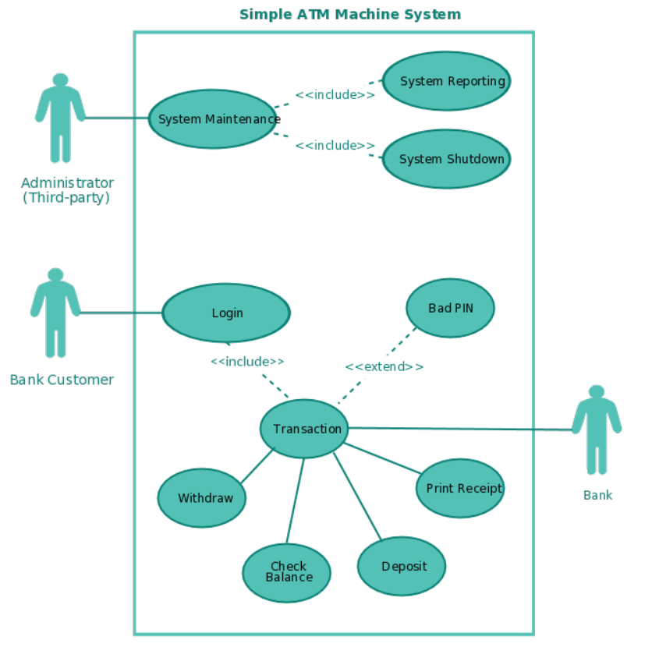
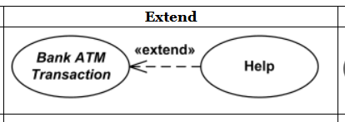
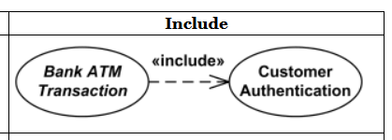
Online order management system use case (optional)

Slide 38
Tabular description of the ‘Transfer data’ use-case
MHC-PMS: Transfer data
Actors | Medical receptionist, patient records system (PRS)
Description | A receptionist may transfer data from the Mentcare system to a general patient record database that is maintained by a health authority. The information transferred may either be updated personal information (address, phone number, etc.) or a summary of the patient’s diagnosis and treatment.
Data | Patient’s personal information, treatment summary
Stimulus | User command issued by medical receptionist
Response | Confirmation that PRS has been updated
Comments | The receptionist must have appropriate security permissions to access the patient information and the PRS.

Slide 39
Sequence diagrams
Sequence diagrams are used to model the interactions between –
the actors and the objects (entity) in a system
the interactions between the objects themselves
A sequence diagram shows the sequence of interactions that take place during a particular use case or use case instance.
A sequence diagram simply depicts interaction between objects in a sequential order i.e. the order in which these interactions take place.
Sequence diagrams can be more than one.

Slide 40
Sequence diagrams notations
An Actor element can be used to represent the user initiating the flow of events.
actors are used to depict objects external to the system
actors can mean a human user, a machine, or even another system or subsystem
An Entity is a stereotyped Object that models a storage or persistence mechanism that captures the information or knowledge in a system.
Objects are internal to the system

Slide 41
Sequence diagrams notations
The objects and actors involved are listed along the top of the diagram, with a dotted line drawn vertically from these.
the rectangle on the dotted lines indicates the lifeline of the object concerned (i.e., the time that object instance is involved in the computation)
read the sequence of interactions from top to bottom
Interactions between objects are indicated by annotated arrows known as communication messages between objects.

Slide 42
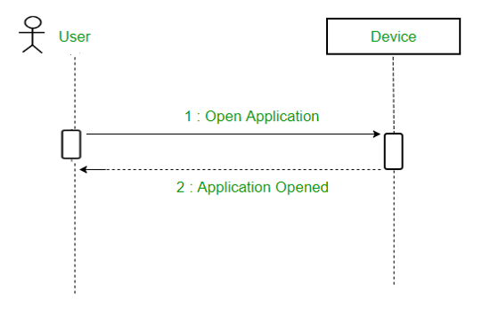
Sequence diagrams

Slide 43
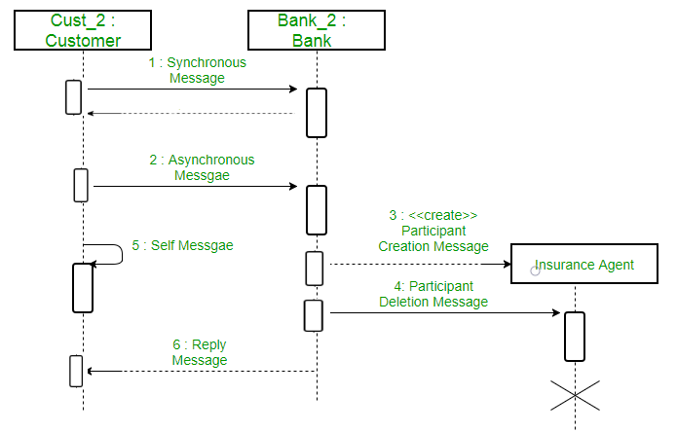
Sequence diagrams

Slide 44
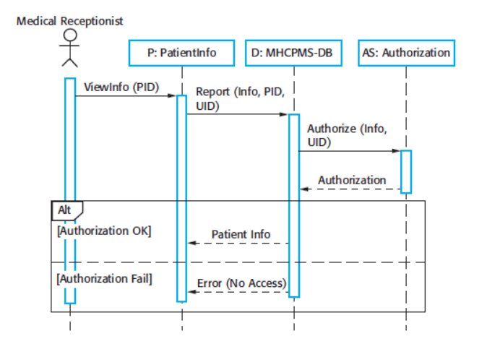
Sequence diagram for View patient information

Slide 45
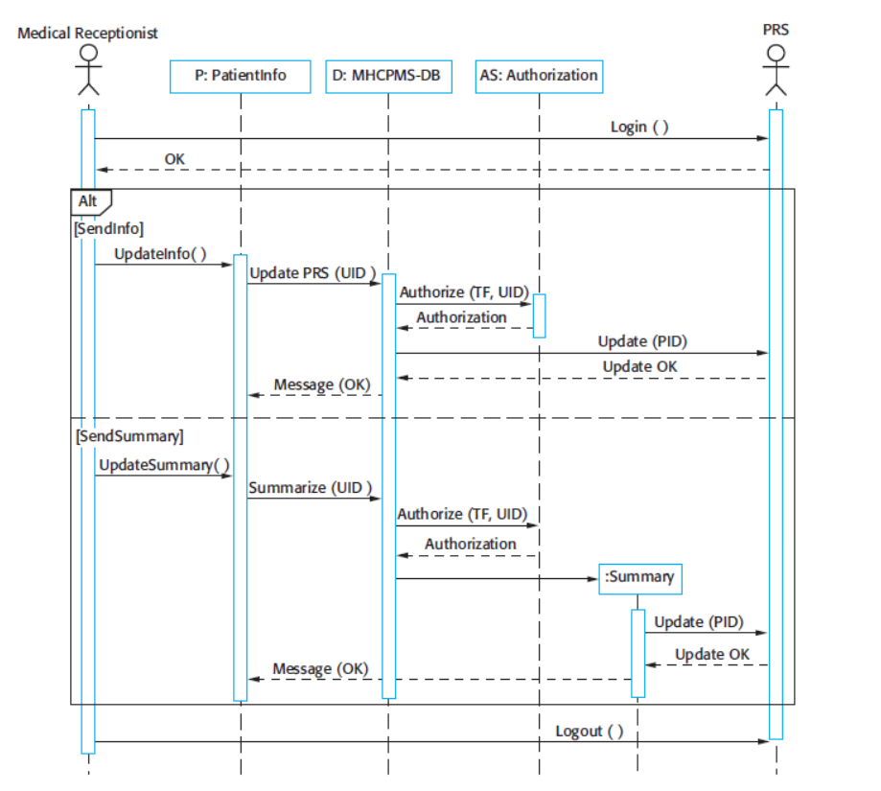
Sequence diagram for Transfer data

Slide 46
Structural models: Class Diagrams

Slide 47
Structural models
Structural models of software display the organization of a system in terms of the components that make up that system and their relationships.
Structural models may be static models, which show the structure of the system design, or dynamic models, which show the organization of the system when it is executing.
Generally class diagram refers to static model.
Provides a view of a system that emphasizes the structure of the objects, including their classifiers, relationships, attributes and operations.

Slide 48
Class diagrams
Class diagrams are used when developing an object-oriented system model to show the classes in a system and the associations between these classes.
An object class can be thought of as a general definition of one kind of system object.
An association is a link between classes that indicates that there is some relationship between these classes.
Objects represent something in the real world, such as a patient, a prescription, doctor, etc.

Slide 49
Class diagram notation
Rectangles with two segments are used to represent an object class.
one segment for different attributes/properties
Another segment for associated functions
Association is represent using annotated straight lines.
type of relationship must be specified (one-to-one, one-to-many, many-to-many etc.)
Aggregation and generalization must be specified if required.

Slide 50
UML classes and association

Slide 51
Classes and associations in the MHC-PMS

Slide 52
The Consultation class

Slide 53
Generalization
Generalization is an everyday technique that we use to manage complexity.
Entities are defined by more general classes (animals, cars, houses, etc.) and learn the characteristics of these classes.
This allows us to infer that different members of these classes have some common characteristics e.g. owl and parrot are birds.

Slide 54
Generalization
In a generalization, the attributes and operations associated with higher-level classes are also associated with the lower-level classes.
The lower-level classes are subclasses inherit the attributes and operations from their superclasses. These lower-level classes then add more specific attributes and operations.

Slide 55
Object class aggregation models
An aggregation model shows how classes that are collections are composed of other classes.

Slide 56
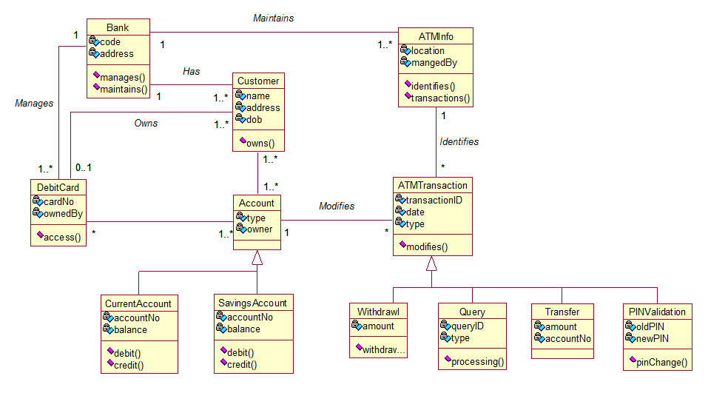
Class diagram of an ATM system

Slide 57
Behavioral models: State diagrams

Slide 58
Behavioral models
Behavioral models are models of the dynamic behavior of a system as it is executing. They show what happens or what is supposed to happen when a system responds to a stimulus from its environment.
You can think of these stimuli as being of two types:
Data Some data arrives that has to be processed by the system.
Events Some event happens that triggers system processing. Events may have associated data, although this is not always the case.

Slide 59
Data-driven modeling
Many business systems are data-processing systems that are primarily driven by data. They are controlled by the data input to the system, with relatively little external event processing.
Data-driven models show the sequence of actions involved in processing input data and generating an associated output.
They are particularly useful during the analysis of requirements as they can be used to show end-to-end processing in a system.

Slide 60
An activity model of the insulin pump’s operation

Slide 61
Event-driven modeling
Real-time systems are often event-driven, with minimal data processing.
Event-driven modeling shows how a system responds to external and internal events.
It is based on the assumption that a system has a finite number of states and that events (stimuli) may cause a transition from one state to another.

Slide 62
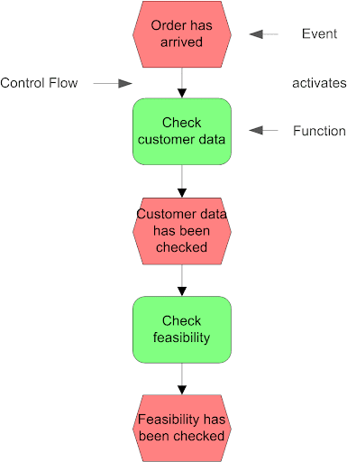
Event-driven modeling

Slide 63
State machine models
These model the behaviour of the system in response to external and internal events.
They show the system’s responses to stimuli so are often used for modelling real-time systems.
State machine models show system states as nodes and events as arcs between these nodes.
When an event occurs, the system moves from one state to another.

Slide 64
State diagram of a microwave oven

Slide 65
States and stimuli for the microwave oven (a)
State | Description
Waiting | The oven is waiting for input. The display shows the current time.
Half power | The oven power is set to 300 watts. The display shows ‘Half power’.
Full power | The oven power is set to 600 watts. The display shows ‘Full power’.
Set time | The cooking time is set to the user’s input value. The display shows the cooking time selected and is updated as the time is set.
Disabled | Oven operation is disabled for safety. Interior oven light is on. Display shows ‘Not ready’.
Enabled | Oven operation is enabled. Interior oven light is off. Display shows ‘Ready to cook’.
Operation | Oven in operation. Interior oven light is on. Display shows the timer countdown. On completion of cooking, the buzzer is sounded for five seconds. Oven light is on. Display shows ‘Cooking complete’ while buzzer is sounding.
Notes:
This simple microwave has a switch to select full or half power, a numeric keypad to input the
cooking time, a start/stop button, and an alphanumeric display.

Slide 66
Model-driven engineering

Slide 67
Model-driven engineering
Model-driven engineering (MDE) is an approach to software development where models rather than programs are the principal outputs of the development process.
The programs that execute on a hardware/software platform are then generated automatically from the models.
Proponents of MDE argue that this raises the level of abstraction in software engineering so that engineers no longer have to be concerned with programming language details or the specifics of execution platforms.
Notes:
In Model Driven Engineering, the stage of the process in which the design (i.e. the shared model) is translated into code
is largely automated. Depending on the technology used, changes in the model can be converted into error-free code with one touch of the button.

Slide 68
Usage of model-driven engineering
Model-driven engineering is still at an early stage of development, and it is unclear whether or not it will have a significant effect on software engineering practice.
Pros
Allows systems to be considered at higher levels of abstraction
Generating code automatically means that it is cheaper to adapt systems to new platforms.
Cons
Informal models are abstract but not necessarily right for implementation.
Savings from generating code may be outweighed by the costs of developing translators for new platforms.

Slide 69
Types of model
A computation independent model (CIM)
A CIM is also often referred to as a business or domain model because it uses a vocabulary that is familiar to the subject matter experts (SMEs).
It presents exactly what the system is expected to do, but hides all information technology related specifications to remain independent of how that system will be (or currently is) implemented.
The CIM plays an important role in bridging the gap which typically exists between these domain experts and the information technologists responsible for implementing the system.

Slide 70
Types of model
Platform independent models (PIM)
A PIM exhibits a sufficient degree of independence so as to enable its mapping to one or more platforms.
This is commonly achieved by defining a set of services in a way that abstracts out technical details.
Other models then specify a realization of these services in a platform specific manner.

Slide 71
Types of model
Platform specific models (PSM)
A PSM combines the specifications in the PIM with the details required to stipulate how a system uses a particular type of platform.
If the PSM does not include all of the details necessary to produce an implementation of that platform it is considered abstract (meaning that it relies on other explicit or implicit models which do contain the necessary details).

Slide 72
Adoption of MDA
A range of factors has limited the adoption of MDE/MDA
Specialized tool support is required to convert models from one level to another
There is limited tool availability and organizations may require tool adaptation and customization to their environment
For the long-lifetime systems developed using MDA, companies are reluctant to develop their own tools or rely on small companies that may go out of business

Slide 73
Adoption of MDA
Models are a good way of facilitating discussions about a software design. However the abstractions that are useful for discussions may not be the right abstractions for implementation.
For most complex systems, implementation is not the major problem – requirements engineering, security and dependability, integration with legacy systems and testing are all more significant.

Slide 74
Adoption of MDA
The arguments for platform-independence are only valid for large, long-lifetime systems. For software products and information systems, the savings from the use of MDA are likely to be outweighed by the costs of its introduction and tooling.
The widespread adoption of agile methods over the same period that MDA was evolving has diverted attention away from model-driven approaches.

Slide 75
Key points
A model is an abstract view of a system that ignores system details. Complementary system models can be developed to show the system’s context, interactions, structure and behavior.
Context models show how a system that is being modeled is positioned in an environment with other systems and processes.
Use case diagrams and sequence diagrams are used to describe the interactions between users and systems in the system being designed. Use cases describe interactions between a system and external actors; sequence diagrams add more information to these by showing interactions between system objects.
Structural models show the organization and architecture of a system. Class diagrams are used to define the static structure of classes in a system and their associations.

Slide 76
Key points
Behavioral models are used to describe the dynamic behavior of an executing system. This behavior can be modeled from the perspective of the data processed by the system, or by the events that stimulate responses from a system.
Activity diagrams may be used to model the processing of data, where each activity represents one process step.
State diagrams are used to model a system’s behavior in response to internal or external events.
Model-driven engineering is an approach to software development in which a system is represented as a set of models that can be automatically transformed to executable code.

Slide 77
THANK YOU

